Slide 1
CPSC 483 Decision Trees
Anand Panangadan
apanangadan@fullerton.edu

Slide 2
What we will cover this week
Decision trees
ID3 algorithm
CART algorithm
Entropy

Slide 3
The Data Science Process
Data Visualization
Data analysis
Exploratory Data Analysis
Formatting, Cleaning
Data integration
Storage
Data

Slide 4
Clustering
K-means clustering

Slide 5
Supervised Learning
Features
Labels
Petal Length | Petal Width | Sepal Length | Sepal Width | Species
5.1 | 3.5 | 1.4 | 0.2 | Setosa
4.9 | 3.0 | 1.4 | 0.2 | Setosa
6.2 | 2.9 | 4.3 | 1.3 | Versicolor
6.3 | 3.3 | 6.0 | 2.5 | Virginica
5.1 | 2.5 | 3.0 | 1.1 | Versicolor
7.1 | 3.0 | 5.9 | 2.1 | Virginica
Training data
5.1 | 3.5 | 1.4 | 0.2 | ?
7.1 | 3.0 | 5.9 | 2.1 | ?
Predictions

Slide 6
Supervised Learning
Features
Labels
Petal Length | Petal Width | Sepal Length | Sepal Width | Species
5.1 | 3.5 | 1.4 | 0.2 | Setosa
4.9 | 3.0 | 1.4 | 0.2 | Setosa
6.2 | 2.9 | 4.3 | 1.3 | Versicolor
6.3 | 3.3 | 6.0 | 2.5 | Virginica
5.1 | 2.5 | 3.0 | 1.1 | Versicolor
7.1 | 3.0 | 5.9 | 2.1 | Virginica
Training data
Split for evaluation
Test data

Slide 7
Unsupervised Learning
Features
Labels
Petal Length | Petal Width | Sepal Length | Sepal Width | Species
5.1 | 3.5 | 1.4 | 0.2 | Setosa
4.9 | 3.0 | 1.4 | 0.2 | Setosa
6.2 | 2.9 | 4.3 | 1.3 | Versicolor
6.3 | 3.3 | 6.0 | 2.5 | Virginica
5.1 | 2.5 | 3.0 | 1.1 | Versicolor
7.1 | 3.0 | 5.9 | 2.1 | Virginica
Also called “Clustering”

Slide 8
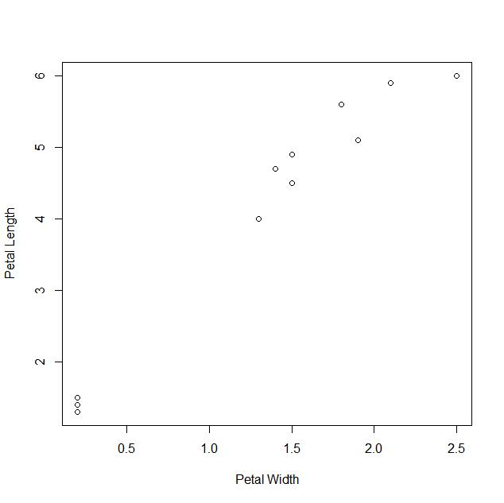
Clustering

Slide 9
Clustering
Partitioning of a data set into subsets (the clusters), so that the data in each subset
are similar to others in that subset
and different from data in other subsets
Similarity defined by some distance measure
Data within a subset are near each other
The challenge:
How do we draw the cluster boundaries?
Clustering algorithms

Slide 10
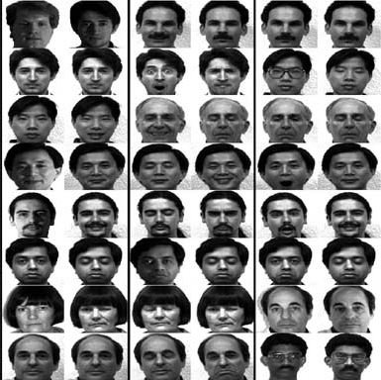
Clustering example
Clustering/Unsupervised learning

Slide 11
K-means clustering algorithm
Most popular clustering algorithm
Start with k initial cluster centers
Iterate:
Assign/cluster each example to closest center
Recalculate centers as the mean of the points in a cluster

Slide 12
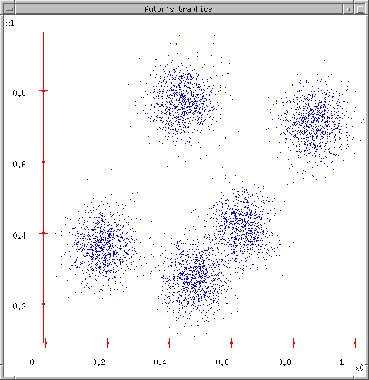
K-means
Ask user how many clusters they’d like. (e.g. k=5)

Slide 13
K-means
Ask user how many clusters they’d like. (e.g. k=5)
Randomly guess k cluster Center locations

Slide 14
K-means
Ask user how many clusters they’d like. (e.g. k=5)
Randomly guess k cluster Center locations
Each datapoint finds out which Center it’s closest to. (Thus each Center “owns” a set of datapoints)

Slide 15
K-means
Ask user how many clusters they’d like. (e.g. k=5)
Randomly guess k cluster Center locations
Each datapoint finds out which Center it’s closest to.
Each Center finds the centroid of the points it owns

Slide 16
K-means
Ask user how many clusters they’d like. (e.g. k=5)
Randomly guess k cluster Center locations
Each datapoint finds out which Center it’s closest to.
Each Center finds the centroid of the points it owns…
…and jumps there
…Repeat until terminated!

Slide 17
K-means: an example

Slide 18
K-means: Initialize centers randomly

Slide 19
K-means: assign points to nearest center

Slide 20
K-means: readjust centers

Slide 21
K-means: assign points to nearest center

Slide 22
K-means: readjust centers

Slide 23
K-means: assign points to nearest center

Slide 24
K-means: readjust centers

Slide 25
K-means: assign points to nearest center
No changes: Done

Slide 26
K-means
Iterate:
Assign each data point to closest center
Recalculate centers as the mean of the points in a cluster

Slide 27
K-means
Iterate:
Assign each data point to closest center
Recalculate centers as the mean of the points in a cluster
iterate over each point:
- get distance to each cluster center
- assign to closest center
Which distance measure?

Slide 28
Distance measures
Euclidean:

Slide 29
K-means
Iterate:
Assign/cluster each example to closest center
Recalculate centers as the mean of the points in a cluster
Where are the cluster centers?

Slide 30
K-means
Iterate:
Assign/cluster each example to closest center
Recalculate centers as the mean of the points in a cluster
Mean of the points in the cluster:

Slide 31
K-means convergence
When do we stop the algorithm?
A fixed number of iterations
partitions unchanged
Cluster centers don’t change

Slide 32
K-means loss function
K-means tries to minimize what is called the k-means loss function:
that is, the sum of the squared distances from each point to the associated cluster center

Slide 33
Minimizing k-means loss
Iterate:
1. Assign/cluster each example to closest center
2. Recalculate centers as the mean of the points in a cluster
Each step of k-means moves towards reducing this loss function
Basis of proof that k-means converges to a solution in a finite number of steps

Slide 34
It converges – but will we find the optimal configuration?
Not always
Example: a configuration that has converged, but does not have the minimum loss

Slide 35
Will we find the optimal configuration?
A configuration that has converged, but does not have the minimum loss

Slide 36
Minimizing k-means loss
Iterate:
1. Assign/cluster each example to closest center
2. Recalculate centers as the mean of the points in a cluster
NO! It will find a minimum.
Unfortunately, the k-means loss function is generally not convex and for most problems has many, many minima
We’re only guaranteed to find one of them

Slide 37
K-means in scikit-learn
from sklearn.cluster import Kmeans
kmeans = KMeans(n_clusters= 3, n_init=10, random_state=42)
y_pred = kmeans.fit_predict(X)
y_pred
kmeans.cluster_centers_

Slide 38
Classwork
Cluster the iris dataset into 3 clusters using all four Petal/Sepal columns
Compare the clusters with the true labels (Species)
Check if increasing random restarts increases clustering accuracy
Optional parameter n_init to kmeans

Slide 39
Textbook code
Textbook code
Textbook code on Google Colab
Open 09_unsupervised_learning.ipynb

Slide 40
Seed choice
Results can vary drastically based on seed selection
Some seeds can result in poor convergence rate, or convergence to sub-optimal clusterings
Common heuristics
Random centers in the space
Randomly pick data points
Points least similar to any existing center
Furthest centers heuristic
Do many runs of k-means, each from a different random start configuration
n_init parameter in Kmeans()

Slide 41
K-means: Initialize centers randomly
What would happen here?

Slide 42
K-means: Initialize centers randomly
What would happen here?

Slide 43
Furthest centers heuristic
μ₁ = pick random point
for i = 2 to K:
μ_{i} = point that is furthest from any previous centers
point with the largest distance to any previous center
smallest distance from x to any previous center

Slide 44
K-means: Initialize furthest from centers
Pick a random point for the first center

Slide 45
K-means: Initialize furthest from centers
What point will be chosen next?

Slide 46
K-means: Initialize furthest from centers
Furthest point from center
What point will be chosen next?

Slide 47
K-means: Initialize furthest from centers
Furthest point from center
What point will be chosen next?

Slide 48
K-means: Initialize furthest from centers
Furthest point from center

Slide 49
Furthest points concerns
If k = 4, which points will get chosen?

Slide 50
Furthest points concerns
If we do a number of trials, will we get different centers?
Notes:
yes and no
we will get different centers, but the three outliers will always get chosen!

Slide 51
Furthest points concerns
Doesn’t deal well with outliers

Slide 52
Classwork
11
10
9
8
Pick 3 centers using the furthest distance heuristic
Pick 1st center randomly
(repeat 3 times)
7
6
5
4
1
2
3

Slide 53
Weaknesses of K-Mean Clustering
Sensitive to initial conditions: Initial centers affect the final clusters
The number of clusters, K, must be determined before hand.
The order of the data points in the data set matters
Algorithm converges but not necessarily to the global optimum

Slide 54
Strengths of K-Means Clustering
Computationally efficient
Linear in the number of data points
Improvements to seed selection continue to be made
K-means++

Slide 55
K-means++
μ₁ = pick random point
for k = 2 to K:
for i = 1 to N:
s_{i} = min d(x_{i}, μ_{1…k-1}) // smallest distance to any center
μ_{k} = randomly pick point proportional to s
How does this help?

Slide 56
K-means++
μ₁ = pick random point
for k = 2 to K:
for i = 1 to N:
s_{i} = min d(x_{i}, μ_{1…k-1}) // smallest distance to any center
μ_{k} = randomly pick point proportional to s
Makes it possible to select other points
if #points >> #outliers, we will pick good points
Makes it non-deterministic, which will help with random runs
Nice theoretical guarantees!

Slide 57
Hard vs. soft clustering
Hard clustering: Each example belongs to exactly one cluster
Soft clustering: An example can belong to more than one cluster (probabilistic)
Makes more sense for applications like creating hierarchies
You may want to put a pair of sneakers in two clusters:
(i) sports apparel
(ii) shoes

Slide 58
Type of Clustering Algorithms
Flat algorithms
Start with a random (partial) partitioning
Refine it iteratively
K means clustering
Hierarchical algorithms
Bottom-up, agglomerative
Top-down, divisive

Slide 59
Single Linkage Hierarchical Clustering
Say “Every point is its own cluster”

Slide 60
Single Linkage Hierarchical Clustering
Say “Every point is its own cluster”
Find “most similar” pair of clusters

Slide 61
Single Linkage Hierarchical Clustering
Say “Every point is its own cluster”
Find “most similar” pair of clusters
Merge it into a parent cluster

Slide 62
Single Linkage Hierarchical Clustering
Say “Every point is its own cluster”
Find “most similar” pair of clusters
Merge it into a parent cluster
Repeat

Slide 63
Single Linkage Hierarchical Clustering
Say “Every point is its own cluster”
Find “most similar” pair of clusters
Merge it into a parent cluster
Repeat

Slide 64
Single Linkage Hierarchical Clustering
How do we define similarity between clusters?
Minimum distance between points in clusters
Maximum distance between points in clusters
Average distance between points in clusters
Say “Every point is its own cluster”
Find “most similar” pair of clusters
Merge it into a parent cluster
Repeat…until you’ve merged the whole dataset into one cluster
Dendrogram: a hierarchy of datapoints

Slide 65
Evaluation of clustering

Slide 66
Clustering and cluster validity assessment
Data on a 2D space

Slide 67
Cluster validity assessment
k = 2
k = 4
Clustering 1
Clustering 2

Slide 68
Evaluating clustering
External metrics
Computed from a comparison to correct clustering (or classification) labels.
Internal metrics
Computed solely from the composition of a cluster, with no recourse to external information.

Slide 69
Evaluating clustering
External criterion
Purity
F-measure
Rand index
Internal criterion
Compactness
Dunn index

Slide 70
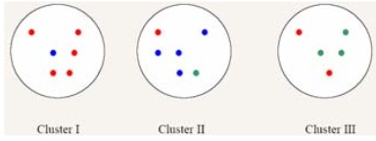
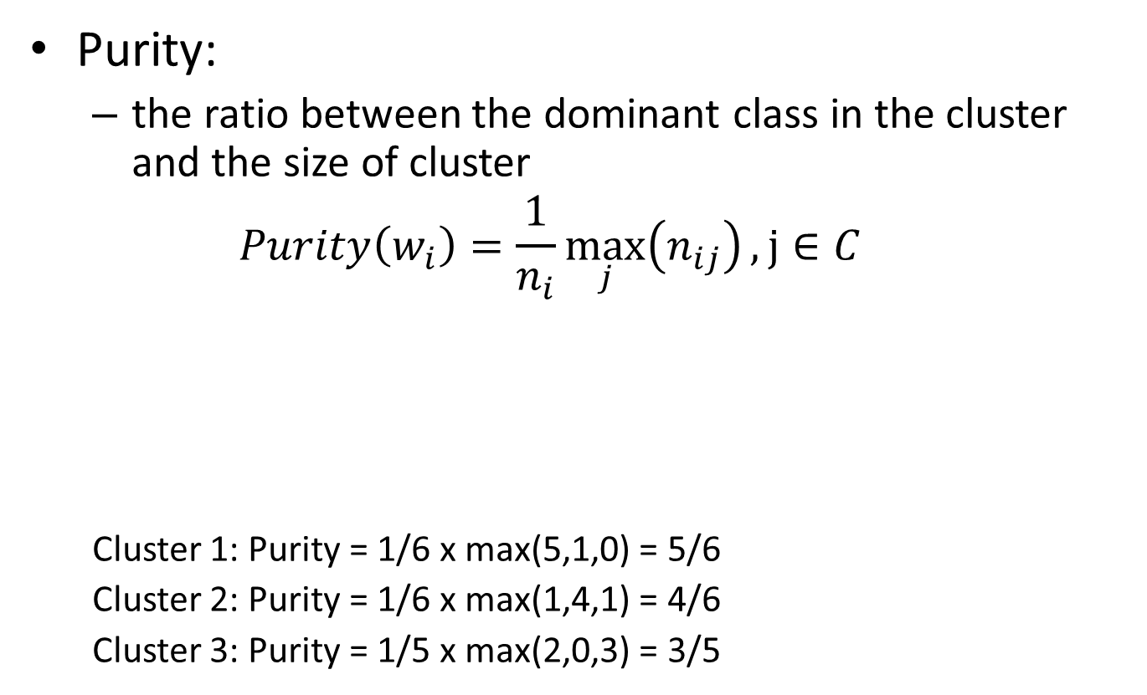
Evaluating clustering - Purity
Purity:
the ratio between the dominant class in the cluster and the size of cluster
$$Purity\left(w_{i}\right)=\frac{1}{n_{i}}\max_{j}\left(n_{ij}\right), j∈C$$
Cluster 1: Purity = 1/6 x max(5,1,0) = 5/6
Cluster 2: Purity = 1/6 x max(1,4,1) = 4/6
Cluster 3: Purity = 1/5 x max(2,0,3) = 3/5

Slide 71
Evaluating clustering – F-measure
Let:
be the target and computed clusterings, respectively.
TC = original data set

Slide 72
Evaluating clustering – F-measure
Define:
a: number of pairs of items that belong to the same cluster in both CC and TC
b: number of pairs of items that belong to different clusters in both CC and TC
c: number of pairs of items that belong to the same cluster in CC but different clusters in TC
d: number of pairs of items that belong to the same cluster in TC but different clusters in CC

Slide 73
Evaluating clustering – F-measure

Slide 74
Evaluating clustering – Rand Index
Measure of clustering agreement: how similar are these two ways of partitioning the data?

Slide 75
Internal Metrics
Assume no target clustering
Attempt to capture some intrinsic properties of the clustering
Compactness
Dunn index
Distance-based

Slide 76
Compactness
Members of a cluster are all similar and close together
sum of the squared distances of instances to the cluster center
where c is the centroid of a cluster C, made up of instances X_{c}.
Overall compactness of a particular clustering
Sum of the compactness of the individual clusters
A single number allows comparing different clusterings
Unfortunately:
Compactness is usually maximized when there are many clusters
Cannot compare clusterings with different k

Slide 77
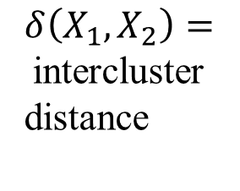
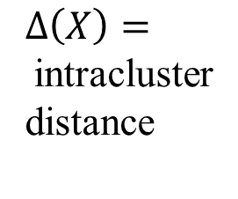
Dunn index
Ratio of smallest inter-cluster distance over largest intra-cluster distance
In a good clustering:
Points within a cluster are close together: intracluster distance
Points in different clusters are far apart: intercluster distance
$Δ\left(X\right)=$intracluster distance
$δ\left(X_{1},X_{2}\right)=$intercluster distance

Slide 78
Dunn index
Many ways to define the intra-cluster distance
distance between the farthest two points inside a cluster
mean of all the pairwise distances between data points inside the cluster
Sum of distances of each data point from the cluster centroid

Slide 79
Dunn index
Many ways to define the inter-cluster distance
Distance between the closest two data points
one in each cluster
Distance between the farthest two data points
Distance between the centroids

Slide 80
Dunn index
This index aims at identifying sets of clusters that are compact and well separated
For any partition U ↔ X: X₁ ∪... X_{i} ∪… X, the Dunn‘s validation index is defined as:
δ(X_{i}, X_{j}): inter-cluster distance between clusters X_{i} and X_{j}
Δ(X_{k}): intra-cluster distance of cluster X_{k}
c: number of clusters of partition U
Dunn index: ratio of smallest inter-cluster distance over largest intra-cluster distance
Large values of V correspond to good clusters
The number of clusters that maximises V is taken as the optimal number of clusters, c.

Slide 81
Dunn index
Advantages
Can compare clusterings with different k
Disadvantages
Computationally inefficient
Distances between all pairs: O(n²)
Sensitive to outliers

Slide 82
Comment on Cluster Validity
“The validation of clustering structures is the most difficult and frustrating part of cluster analysis.
Without a strong effort in this direction, cluster analysis will remain a black art accessible only to those true believers who have experience and great courage.”
Algorithms for Clustering Data, Jain and Dubes

Slide 83
Acknowledgment
Andrew Moore, CMU
Link to the source repository of tutorials: http://www.cs.cmu.edu/~awm/tutorials
David Kauchak, Pomona College
http://www.cs.pomona.edu/~dkauchak/classes/f13/cs451-f13/

Slide 84
Acknowledgement
Many slides from Dr. Christopher Ryu
Content based on “Hands-On Machine Learning with Scikit-Learn, Keras, and TensorFlow,” Aurélien Géron, 3rd Edition (October 2022), O'Reilly Media, Inc.

